Slide 1
MOBILE RECIPE GENERATOR
27th November 2023
PREPARED BY
FARHANA P (MES22MCA-2018)

Slide 2
GUIDED BY
MR. GEEVAR C. ZACHARIAS
ASSISTANT PROFESSOR
MASTER OF COMPUTER APPLICATIONS
MES COLLEGE OF ENGINEERING , KUTTIPPURAM

Slide 3
CONTENTS
Overview
Functionality
Software & Hardware Requirements
Product Backlog
Project Plan
Sprint
DFD
Entity Diagram

Slide 4
OVERVIEW
The Recipe Generator is a mobile application that enables users to generate recipes based on the ingredients they have at hand. It aims to simplify the decision-making process for cooking by providing users with tailored recipes depending on available ingredients. Simply scan the barcodes or manually input the ingredients you have in your pantry, fridge, or freezer. Recipe Generator's powerful algorithm instantly generates a list of recipes you can cook with your available ingredients. Narrow down your recipe choices by selecting dietary preferences, cuisine types, or meal categories. Each recipe comes with easy-to-follow, step-by-step instructions, making cooking a breeze even for beginners.
Users can search for recipes based on various criteria such as ingredients, cuisine, dietary preferences (e.g., vegetarian, vegan, gluten-free), cooking time, and difficulty level. Users can input the ingredients they have on hand, and the app will suggest recipes that can be prepared with those ingredients, reducing food waste. The app can help users plan their meals by offering daily or weekly meal suggestions based on their preferences and dietary restrictions.

Slide 5
OVERVIEW
Users can create profiles and specify their dietary preferences and restrictions, allergies, and taste preferences. The app uses this information to tailor recipe recommendations. Curated collections of recipes for special occasions, holidays, or specific themes (e.g., healthy eating, comfort food) are available. Detailed cooking instructions with images or videos guide users through each recipe's preparation and cooking process. Nutritional data for each recipe, including calories, fat, protein, and other relevant information, is provided to help users make informed choices. Users can save their favorite recipes for quick access in the future, creating a personalized recipe collection. The app can suggest ingredient substitutions for users who may not have all the required ingredients for a recipe.

Slide 6
OVERVIEW
FUNCTIONALITY:
Recipe Search :
Users can search for recipes based on keywords, ingredients, cuisine types, dietary restrictions, and cooking time.
Ingredient Suggestion:
Users can input the ingredients they have on hand, and the app suggests recipes they can make with those ingredients.
Dietary Preferences:
Users can set dietary preferences and restrictions (e.g., vegetarian, vegan, gluten-free) to filter recipe results accordingly.
Kitchen Appliance Integration:
Integration with smart kitchen appliances (e.g., ovens, scales) for precise cooking instructions and control.

Slide 7
FUNCTIONALITY:
Recipe Details:
Each recipe includes details like ingredients, step-by-step instructions, preparation time, cooking time, and serving size.
Nutritional Information:
Users can view nutritional data for each recipe, including calorie count, macronutrient breakdown, and sometimes even micronutrients.
Ingredient Substitutions:
The app may suggest ingredient substitutions for users who lack specific items.

Slide 8
SOFTWARE & HARDWARE REQUIREMENTS
SOFTWARE REQUIREMENTS
Front end : Flutter
Back end : Firebase
OS :Windows 10
TOOLS
Visual Code Studio
Firebase
HARDWARE REQUIREMENTS
Processor : Intel(R) Core(TM) i7-5500U CPU @ 2.40GHz 2.40 GHz
Ram : 8.00 GB
Storage :256Gb HDD

Slide 9
PRODUCT BACKLOG
ID | PRIORITY | SIZE (Hours) | SPRINT | STATUS | NAME
1 | Medium | 3 | 1 | Completed | Form Design
2 | Medium | 1 |  | Completed | User Panel
3 | High | 4 | 2 | Completed | Table Design
4 | High | 23 |  | Completed | Coding
5 | Medium | 4 | 3 | Completed | Testing Data
6 | High | 6 |  | Completed | Output Generation

Slide 10
PROJECT PLAN
ID | TASK NAME | START DATE | END DATE | PROJECT HOURS | STATUS
1 | Sprint 1 | 15/09/2023 | 12/10/2023 | 13 | Completed
2 | Sprint 2 | 13/10/2023 | 03/11/2023 | 14 | Completed
3 | Sprint 3 | 08/11/2023 | 30/11/2023 | 14 | Completed

Slide 11
SPRINT PLAN
SPRINT 1
Backlog Item | Status and Completion date | Original Estimate in hours | Day 1 15/09 | Day 2 20/09 | Day 3 21/09 | Day 4 28/09 | Day 5 29/09 | Day 6 04/10 | Day 7 05/10 | Day 8 06/10 | Day 9 11/10 | Day 10 12/10
Form Design | 04/10/2023 | 2 | 1 | 0 | 0 | 0 | 0 | 1 | 0 | 0 | 0 | 0
Table Design | 05/10/2023 | 3 | 1 | 1 | 0 | 0 | 0 | 0 | 1 | 0 | 0 | 0
Coding | 11/10/2023 | 6 | 0 | 0 | 1 | 1 | 1 | 0 | 0 | 2 | 1 | 0
Testing & Validation | 12/10/2023 | 2 | 0 | 0 | 0 | 0 | 1 | 0 | 0 | 0 | 0 | 1
Total |  | 13 | 2 | 1 | 1 | 1 | 2 | 1 | 1 | 2 | 1 | 1

Slide 12
SPRINT PLAN
SPRINT 2
Backlog Item | Status and Completion date | Original Estimate in hours | Day 1 13/10 | Day 2 18/10 | Day 3 19/10 | Day 4 20/10 | Day 5 25/10 | Day 6 26/10 | Day 7 27/10 | Day 8 01/11 | Day 9 02/11 | Day 10 03/11
Form Design | 26/10/2023 | 2 | 1 | 0 | 0 | 0 | 0 | 1 | 0 | 0 | 0 | 0
Table Design | 27/10/2023 | 1 | 0 | 0 | 0 | 0 | 0 | 0 | 1 | 0 | 0 | 0
Coding | 03/11/2023 | 8 | 1 | 1 | 1 | 1 | 0 | 0 | 1 | 1 | 1 | 1
Testing & Validation | 03/11/2023 | 3 | 0 | 0 | 0 | 1 | 1 | 0 | 0 | 0 | 0 | 1
Total |  | 14 | 2 | 1 | 1 | 2 | 1 | 1 | 2 | 1 | 1 | 2

Slide 13
SPRINT PLAN
SPRINT 3
Backlog Item | Status and Completion date | Original Estimate in hours | Day 1 08/11 | Day 2 09/11 | Day 3 10/11 | Day 4 15/11 | Day 5 16/11 | Day 6 17/11 | Day 7 22/11 | Day 8 23/11 | Day 9 24/11 | Day 10 29/11 | Day 11 30/11
Coding | 24/11/2023 | 9 | 1 | 1 | 2 | 0 | 0 | 2 | 1 | 1 | 1 | 0 | 0
Testing & Validation | 30/11/2023 | 5 | 0 | 0 | 0 | 1 | 1 | 0 | 0 | 0 | 1 | 1 | 1
Total |  | 14 | 1 | 1 | 2 | 1 | 1 | 2 | 1 | 1 | 2 | 1 | 1

Slide 14

DFD
LEVEL -0

Slide 15
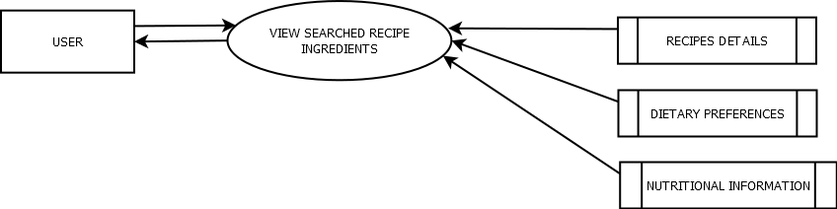
DFD
LEVEL -1

Slide 16
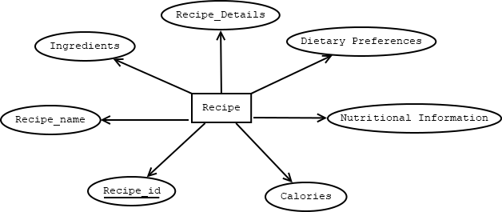
Entity Diagram

Slide 17
Thank you

